Slide 1
Overcoming Impostor Syndrome
[Your name]
[Your title]
[Your affiliation]
[Your email address]
CC BY-SA The Ada Initiative http://adainitiative.org
Notes:
While waiting for people to arrive, point out that they can read the article on Impostor Syndrome in the handout.
Please do not remove the CC BY-SA credit. It is part of the terms of the licensing of these materials to attribute the source of the work. For more information, see https://creativecommons.org/licenses/by-sa/4.0/

Slide 2
About me
[Introduce yourself]
Notes:
Include information about yourself that will help the people in the audience identify with you. Talk about your education, where you grew up, what you do now, any big changes in your career, any major accomplishments, etc.

Slide 3
Format of the workshop
15 min: Introduction
5 min: Split into small groups
10 min: “Take a compliment” exercise
10 min: Values exercise
10 min: Combating negative thoughts exercise
5 min: Wrap-up
Notes:
This is an example schedule. We actually recommend going for at least 90 minutes - just let discussion go on longer during the exercises and report out.

Slide 4
Is this you?
“I'm sorry, but that acceptance letter we sent you was a mistake, you're actually not qualified for that at all...”
Notes:
Ask people to raise their hands if they have ever thought this.

Slide 5
Is this you?
“I'm sorry, but we've reviewed your promotion packet, and you aren't even qualified for the job you're doing right now...”
Notes:
Ask people to raise their hands if they have ever thought this.

Slide 6
Impostor Syndrome
The feeling that you are a fraud or unqualified for the work you are already doing - faking it - and may be found out at any moment
Notes:
Feel free to expand on this definition and give examples of how it operates in your field. Ask people again to raise their hands if they've felt this way. If you have ever felt Impostor Syndrome, this is a good time to mention it.

Slide 7
Impostor Syndrome
Especially common in fields where work is done privately, a finished product is released publicly, and public criticism is common, such as writing, academic research, computer programming, law, etc.
Notes:
Give examples from your field of how work is done privately, then released publicly and criticized, etc.

Slide 8
“In every job I’ve had in the last 25 years, I’ve been the first woman to hold my position—head of computer science and dean of science at the University of British Columbia, dean of engineering at Princeton, and now president of Harvey Mudd College. As my career progressed, so did the intensity of my feelings of failure.”
Maria Klawe, Harvey Mudd president
Notes:
Feel free to replace with examples from your field of extremely successful people talking about feeling like an impostor. The goal of these first few slides is to show people that they are not alone in having these feelings because the people in the room have these feelings, the instructor has these feelings, and famous successful people in their field have these feelings.

Slide 9
“I can't do this. I haven't done enough experiments. I haven't got enough data. I can't write the paper well enough yet or give the talk.”
Cherry Murray, dean of Harvard University's School of Engineering and Applied Sciences

Slide 10
Why?

Slide 11
“Did you get invited to that program committee because you are a woman?”
Notes:
Replace these next two slides with real-world examples that have happened to you or that you can sympathize with, of people openly questioning your competence.

Slide 12
“You aren't a kernel programmer.”

Slide 13
You feel like an impostor because people treat you like one
Sexism says women can't be good at what it is you are doing
People forget facts that don't fit their stereotypes (“prove-it-again bias”)
People act surprised when you are good
People advise you to lower your ambitions
People tell you that you are an impostor

Slide 14
What is the result?
We have less satisfaction in our lives
We waste time over-preparing and worrying instead of doing good work and having fun
We are less effective as colleagues
We ask for less money
We don't ask for challenges
We don't ask for promotions or apply for jobs

Slide 15
Preventing Impostor Syndrome your community or workplace
Be encouraging
Share your own failures
Have a positive and kind community
Make mentoring a first class activity
Document, document, document!

Slide 16
Exercises
Do exercises with your group
No one has to participate
No one has to report out
You can leave, switch tables, or come back at any time for any reason
If someone is bothering you, come find me during discussion or break
Notes:
Emphasize that people can leave at any time or not participate. It is very important that no one feel pressured to share or participate as this workshop can bring up strong feelings.

Slide 17
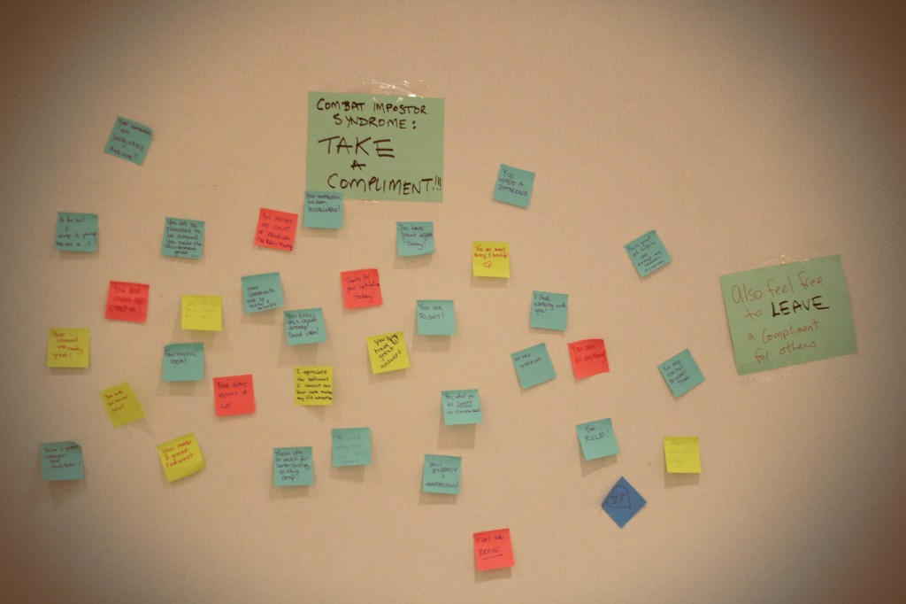
“Take a compliment!”
Notes:
Ask people to take 5 minutes (or whatever your scheduled time is) to write down reasonably generic compliments on their post-it notes. Examples: "You are a good listener." "You work hard." Each person should write 3-5. Then tell them that each person needs to take 2-3 compliments that other people wrote in their group. Then you will ask for volunteers to talk about why they chose the compliments they did. Tell them the remaining compliments will go on a wall and people will be able to take more compliments before they go.
Tell them the purpose of this exercise is to learn to accept and believe positive feedback as much as negative feedback, in order to have a more accurate self-perception.

Slide 18
“Take a compliment!”:
group share
Notes:
Ask people to volunteer why they chose their compliments. You will often notice a theme early on: often people choose compliments that are about how they help other people. Most likely, the class will notice this too and you will want to point out that that is an effect of socialization of women or oppressed groups to prioritize the feelings and success of other people. Encourage people to practice saying "Thank you" and actually accepting compliments. Suggest keeping a folder of compliments, awards, and other positive comments to review before impostor-triggering events like job interviews, talks, or paper submissions.

Slide 19
Values exercise
Notes:
The values exercise is in the handout. Use your copy of the handout to read the instructions to the participants. Explain that the theory of the exercise is that when we focus on acting in concert with our values and judge ourselves on whether we acted in line with them, it counters the negative messages we are getting from the world. Tell them there will be a voluntary group report-out after they finish the exercise.

Slide 20
Values exercise:
group share
Notes:
Ask for volunteers to share what values they picked and what thoughts they had. Again, people will probably notice a trend towards nurturing or caring values, with less friendliness towards anything perceived as self-promoting or self-centered. Encourage people to think about why we are socialized this way and what effect it has on our careers. Often people remark that they didn't even realize some of the values could be viewed positively, such as "ambition," "intellectual status," or "power and authority." Tell people to redo this exercise before interviews, writing resumes, giving talks, or other stressful situations.

Slide 21
Combating negative thoughts
Notes:
This exercise is in the handout but doesn't have explicit instructions. Explain that this exercise is based on CBT - cognitive behavioral therapy - but that "thought record" is much friendlier term. Tell them that it is clinicially proven to change thought patterns. Ask people to choose a specific time that they feel Impostor Syndrome, but to pick a low-stress and low-emotion example for this exercise. Emphasize again that no one has to participate or share if they don't want to. Give one example where you do each of the steps in the headings. Ask people to do this exercise and then optionally talk about it with their group, then optionally share in the report-out. This exercise is very likely to cause strong emotions, so don't skip any of these instructions.

Slide 22
Combating negative thoughts: group share
Notes:
Ask for people who want to share what they worked on in this exercise.

Slide 23
More resources
Denise Paolucci: “Overcoming Impostor Sydrome” (linux.conf.au 2013)
Julie Pagano: “It's Dangerous to Go Alone” (PyCon 2014)
Mood Gym: https://moodgym.anu.edu.au/welcome
Slides, handout, guide for this workshop: http://adainitiative.org/continue-our-work/impostor-syndrome-training/

Slide 24
Thank you!
Notes:
Suggest to people that they might want to put their leftover compliments on the Wall of Compliments, and take some more compliments with them. Remind people to take the handout with them and to redo the exercises when they are facing Impostor Syndrome-triggering events. Ask the participants to give themselves a round of applause for doing hard work for an hour.

